Slide 1
Writing Your Ordination Paper
Northwest Conference Ministerial Association
Friday, April 28, 2017

Slide 2
Your ordination paper is a BIG DEAL!
It is central to the ordination process.
It may be the most important professional paper you’ll write.
It is a personal “statement of faith” as well as a demonstration of your theological and pastoral competence.
It can even be a good time for personal reflection, clarification, and discernment.

Slide 3
This Afternoon we will…
…give a quick overview of the process.
…give basic expectations related to the paper.
…offer suggestions on specific questions.
…address what to expect at your interview.
…answer questions.
…NOT tell you what to write!

Slide 4
The Ordination Process Includes:
Your submission of the ordination paper, a sample sermon, and an up-to-date profile.
Interviews at both conference and denominational levels.
A personal testimony at the NWC annual meeting.
PARTICIPATION in BOTH conference and denominational annual meetings.

Slide 5
The Ordination Paper is...
…the single-most important document in the process.
…designed to show your ability to integrate theory, practice, and self-understanding.
…part of your permanent record as a Covenant Pastor.

Slide 6
Preparing to Write the Paper.
Start Early—a hastily written paper shows!
Review the instructions carefully. Identify the core issue(s) in each section and question.
Involve a mentor early-on—include him or her in editing and proof-reading.
Allow enough time for your work to “season.”

Slide 7
When writing…
READ AND FOLLOW ALL THE INSTRUCTIONS.
Don’t try to show everything you know—be clear, concise, direct, and specific.
Don’t be overly technical, but demonstrate that you are conversant in the relevant issues.
When possible, show your ability to integrate theological principle and pastoral practice.

Slide 8
When writing (cont.)…
Be judicious with the use of quotes, citations, and references.
Pay particular attention to questions that intersect with distinctives of Covenant theology, history, and ministry.
Beware of being overly formal--and of being inappropriately casual.
You will likely draw on previous work, but don’t simply restate it.

Slide 9
When writing (cont.)…
Be honest, authentic, and personal—tell what you believe and how you minister.
When addressing issues where your own convictions may conflict with Covenant thought and practice:
  Be honest about the difference
  Address how you will navigate the issue as a representative of the ECC with both integrity and credibility.

Slide 10
Editing Your Paper
Remember that spelling, punctuation, and formatting do matter!
Consult a reputable writing resource as necessary (e.g. Turabian).
Use your mentor, but consider using more than one “reader.”
Avoid/eliminate redundancy.
Don’t forget section and question headings!

Slide 11
Your Interview:

Slide 12
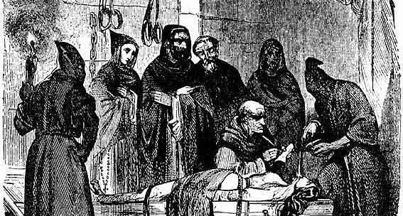
“Welcome to The Inquisition, I mean, ‘your interview.’”

Slide 13
Your Interview will Include:
A short devotional with prayer.
Sharing your faith story and call to ministry.
Discussion of your paper—particularly areas that may need clarification or explanation.
If time, discussion of your sermon.
If time, possible review of your profile.

Slide 14
In your interview, we’re looking for:
A clear sense and affirmation of call
Healthy self-awareness and self-care
Apostolicity
Pastoral competence
Covenant compatibility and collegiality

Slide 15
Interviews have several possible results:
Recommendation for ordination without conditions.
Recommendation with conditions.
Requirement of a major rewrite and a recall interview.
No recommendation.
NOTE: You will not be given an immediate decision. You will be contacted within 24 hours.

Slide 16
Some Final Observations:
Watch for correspondence (email and print) from Danielle Ng (Ordered Ministry) and Cheryl Theilen (NWC) about process, requirements, dates, etc.
Pay attention to deadlines.
Make sure your profile is up-to-date.
Be professional—in both your writing and your interview.

Slide 17
Questions?

